Slide 1
Point and interval estimates
Point estimates?
Parameter | Population | Sample
Size | N | n
Mean | µ
Standard deviation | σ | s
Proportion | π | ρ
Confidence intervals?
Sample sizes?
In this presentation we will provide population estimates for the mean, standard deviation, and proportion.
The types of statistics that we explored within earlier chapters are statistics that provide an answer to a particular question, where we assume that the data collected is from the complete population. In many situations this is not the case, and the data collected represents a sample from a population being measured.

Slide 2
Learning objectives
On completing this unit you should be able to:
Calculate point estimates for population parameters (mean, proportion, and variance) for one and two samples.
Calculate sampling errors and confidence intervals when the population standard deviation is unknown (Student’s t-test only.
Determine sample sizes.
Solve problems using Microsoft Excel and IBM SPSS.

Slide 3

Population Point Estimates
In the previous section we explored the sampling distribution of the mean and proportion and stated that these distributions can be considered to be normal with particular population parameters (µ, σ²). For many populations, it is likely that we do not know the value of the population mean (or proportion).
Fortunately, we can use the sample mean (or proportion) to provide an estimate of the population value. The objective of estimation is to determine the approximate value of a population parameter on the basis of a sample statistic.
The method described in this section is dependent upon the sampling distribution being normally distributed (or approximately) and we can provide two estimates of the population value: point and interval estimate.
A point estimate is a single number
A confidence interval provides information about variability

Slide 4
Types of Estimate & Criteria of a Good Estimator
A point estimate is a sample statistic that is used to estimate an unknown population parameter.
An interval estimate is a range of values used to estimate a population parameter. It indicates error by the extent of its range and by the probability of the true population parameter lying within that range.
Criteria of a good estimator:
Sample mean is an unbiased estimator of the population mean.
An unbiased estimator is consistent if the difference between the estimator and the parameter grows smaller as the sample size increases.
If we have two estimators of the parameter, then the one whose variance is smaller is said to be more efficient. It should be noted that the sample median has a greater variance than the sample mean - so we choose the sample mean rather than sample median.

Slide 5
Point Estimate of Population Mean and Variance
A point estimator draws inferences about a population by estimating the value of an unknown parameter using a single point or data value. The sample mean is the best estimator of the population mean. It is unbiased, consistent, and the most efficient estimator.
Unbiased estimate of population mean, μ:
Unbiased estimate of population standard deviation, σ:
Standard error of the mean, :
Use Excel function STDEV.S() to calculate s.
Similar equations can be written for problems involving the calculation of point estimates: (i) proportions, (ii) pooling sample data from 2 samples.

Slide 6
Point estimates
Example 5.1
An experiment was performed five times on the measurement of the length of rods with the following results: 1.010, 1.012, 1.008, 1.013 and 1.011.
Calculate the unbiased estimates of the mean and variance of possible measurements and give an estimate for the standard error of the mean?
The value of the unbiased estimates of the population mean, standard deviation, and standard error of the mean are provided by solving equations (5.3), (5.7), and (5.9).

Slide 7
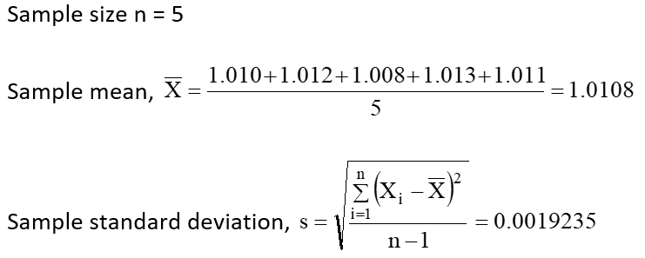
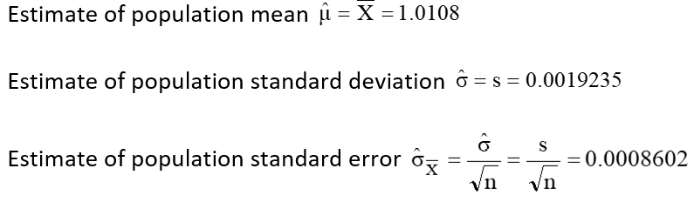
Point estimates continued
Sample values
Population estimates

Slide 8
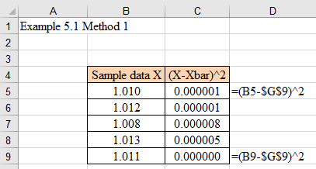
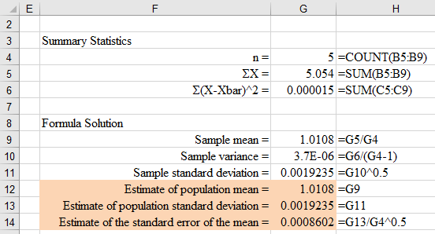
Excel solution (1/2)
Method 1 Formula method – equations 5.3, 5.5, 5.6 and 5.7

Slide 9
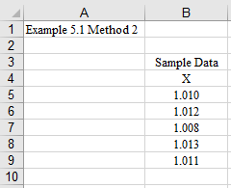
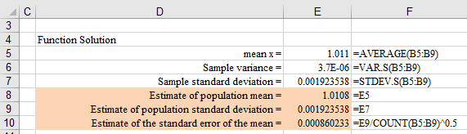
Excel solution (2/2)
Method 2 Excel function method

Slide 10
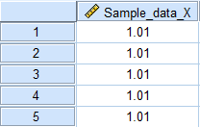
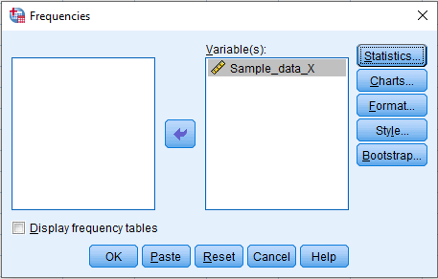
SPSS solution (1/4)
Input data into SPSS (numbers listed to 2 dps)
Frequencies method
Select Analyze > Descriptive Statistics > Frequencies
Switch off Display frequency tables (ignore warning)
Transfer Sample_data_X into the Variable(s) box

Slide 11
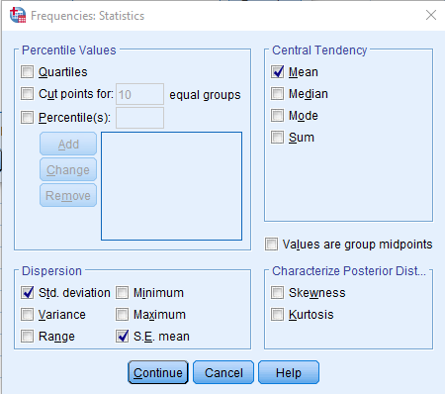
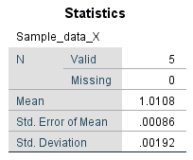
SPSS solution (2/4)
Click on Statistics
Choose Mean, Std.deviation, S.E. mean
SPSS output
Click Continue
Click OK

Slide 12
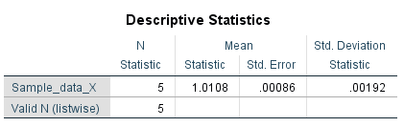
SPSS solution (3/4)
Alternatively, you could use the SPSS Descriptives and Explore menus to provide the results.
Descriptives method
Select Analyze > Descriptive Statistics > Descriptives
Transfer Sample_data_X into the Variable(s) box
Click on Options
Choose Mean, Std.deviation, S.E. mean
Click Continue
Click OK
SPSS output

Slide 13
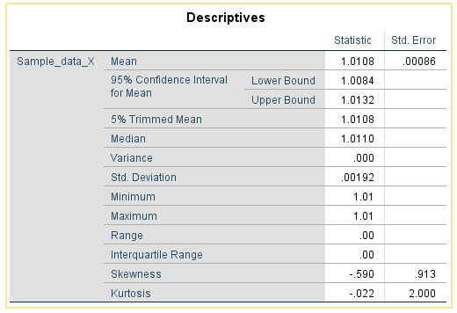
SPSS solution (4/4)
Explore method
Select Analyze > Descriptive Statistics > Explore
Transfer Sample_data_X into the Dependent List box
Click on Statistics
Choose Descriptives
Click Continue
Click OK
SPSS output

Slide 14
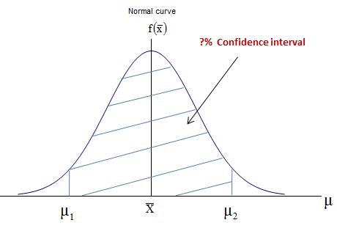
Population Confidence Intervals (CI)
If we assume that the sampling distribution of the sample means are normally distributed then we can provide a measure of this error in terms of a probability value that the value of the population mean will lie within a specified interval - called an interval estimate (or confidence interval, CI), where the interval is centered at the point estimate for the population mean.
We can re-arrange Equation (4.9) to given Equation (5.15):
For a 95% CI, Z= ± 1.96

Slide 15
CI Estimate for μ (σ unknown, n < 30)
In the previous example we calculated the point and interval estimates when the population was normally distributed but the population standard deviation was known.
In most cases the population standard deviation would be an unknown value and we would have to use the sample value to estimate the population value with associated errors.
The population mean estimate is still given by the value of the sample mean but what about the confidence interval? In the previous example the sample mean and size were used to provide this interval but in the new case we have an extra unknown, that as to be estimated from the sample data, to find this confidence interval.
This is often the case in many student research projects. They handle small sizes and the population standard deviation is unknown.

Slide 16


Student’s t-distribution
If we have a small sample and the population is unknown then we can use the Student’s t distribution defined by equation (6.27) to estimate a confidence interval
Assumptions:
Population standard deviation unknown
Population is normally distributed (or approximately)
Use large samples if population not normal
With the degrees of freedom is given by equation (5.19):
The confidence interval is given by equation (5.20):

Slide 17
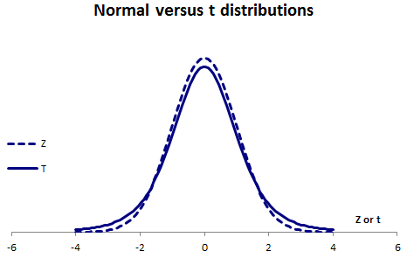
Properties of the t-distribution
The t distribution is symmetric, like the normal distribution, but flatter. Figure 6.33 compares the t distribution with 5 degrees of freedom and the standard normal distribution.
The t distribution is flatter than the normal distribution. Since the t distribution is flatter, the percentage of the distribution within 1.96 standard deviations of the mean is less than the 95% for the normal distribution.
It should be noted that the t distribution → Z distribution as n increases.

Slide 18
Example 5.4 (1/2)
For the following sample of 8 observations from an infinite Normal population find the sample mean and standard deviation and hence determine the standard error, the population standard deviation and a 95% confidence interval for the mean: 10.3, 12.4, 11.6, 11.8, 12.6, 10.9, 11.2, and 10.3.
For this data, we can calculate the summary statistics:
The value of the critical t statistic at a significance level and degrees of freedom can be found from the Student’s t distribution tables.
Sample mean = 11.3875
Sample size, n = 8
Sample standard deviation, s = 0.8741322
ALPHA | 50% | 20% | 10% | 5% | 2.50% | 1%
Df | 0.5 | 0.20 | 0.1 | 0.05 | 0.025 | 0.01
1 | 1.00 | 3.08 | 6.31 | 12.71 | 25.45 | 63.66
2 | 0.82 | 1.89 | 2.92 | 4.30 | 6.21 | 9.92
3 | 0.76 | 1.64 | 2.35 | 3.18 | 4.18 | 5.84
4 | 0.74 | 1.53 | 2.13 | 2.78 | 3.50 | 4.60
5 | 0.73 | 1.48 | 2.02 | 2.57 | 3.16 | 4.03
6 | 0.72 | 1.44 | 1.94 | 2.45 | 2.97 | 3.71
7 | 0.71 | 1.41 | 1.89 | 2.36 | 2.84 | 3.50
8 | 0.71 | 1.40 | 1.86 | 2.31 | 2.75 | 3.36
From Table 5.4, the critical t value = 2.36 when P(T ≥ t) = 0.025 and 7 degrees of freedom.

Slide 19
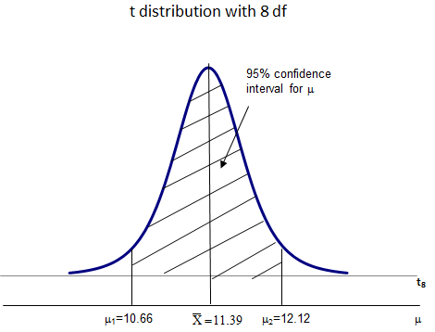
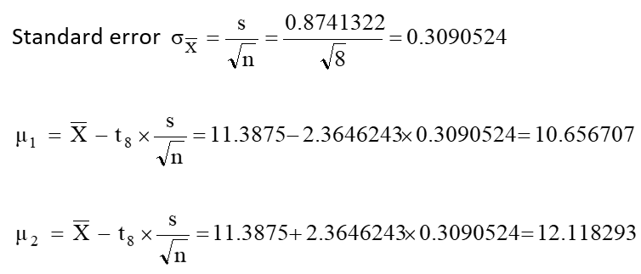
Example 5.4 (2/2)
We are 95% confident that, based on the sample, the true population mean is between 10.6567 and 12.1183

Slide 20
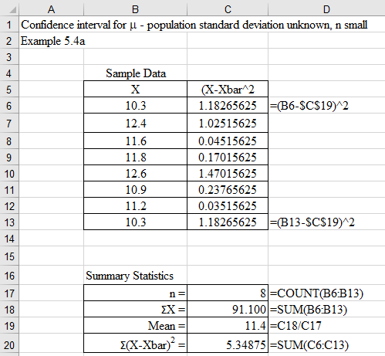
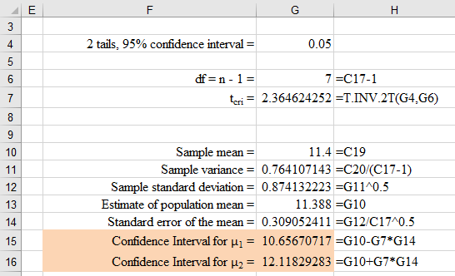
Excel solution (1/2)
Method 1 Excel formula method
We are 95% confident that the population mean is contained within the interval 10.66 to 12.12.

Slide 21
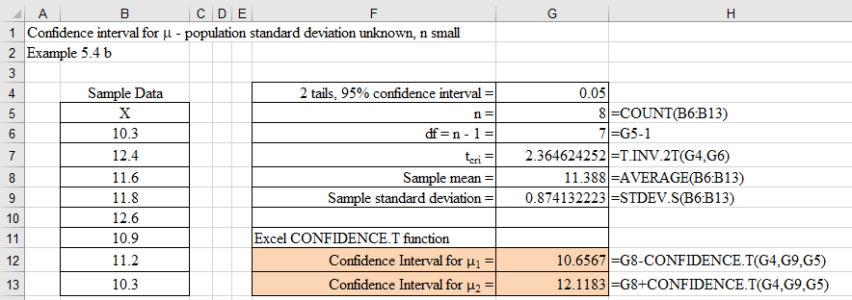
Excel solution (2/2)
Method 2 Excel function method
We are 95% confident that the population mean is contained within the interval 10.66 to 12.12.

Slide 22
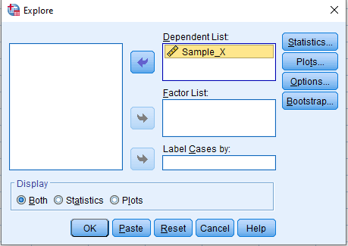
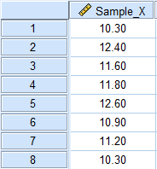
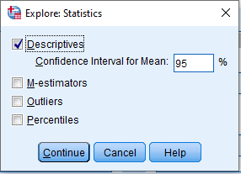
SPSS solution using Explore (1/2)
Enter data into SPSS
Analyze > Descriptive Statistics > Explore
Click on Statistics
Choose Descriptives
Type 95 into the Confidence Interval for the Mean box
Click Continue
Click OK

Slide 23
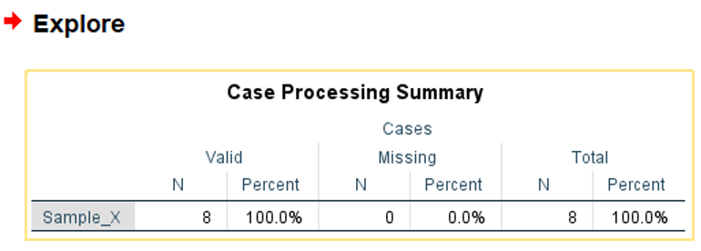
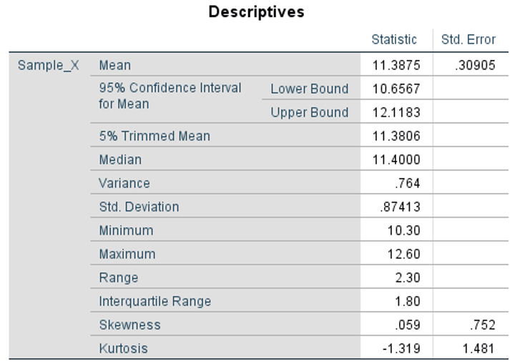
SPSS solution using Explore (2/2)
Conclude, 95% confidence interval for the population mean using the Student’s t distribution is:
10.6567 to 12.1183.
This agrees with the Excel solution

Slide 24


Calculating sample sizes (1/3)
We can control the width of the confidence interval by determining the sample size necessary to produce narrow intervals. For example, if we assume that we are sampling a mean from a population that is normally distributed then we can modify equation (5.21) to calculate an appropriate sample size using equation (5.24):
(5.24)
One way to look at equation (5.24) is to say that $\overline{x}−μ$ is in fact an interval within which our estimate should fall. In this case we can re-write the above equation as:
(5.25)

Slide 25
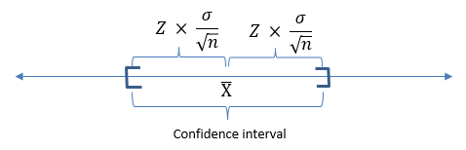

Calculating sample sizes (2/3)
Why number 2 in equation (5.25)? The graph in Figure 5.39 below illustrates the point.
Another way to look at equation (5.24) is to say that $\overline{x}−μ$ is effectively an error (E) between estimated mean value and the true mean value.
(5.26)

Slide 26


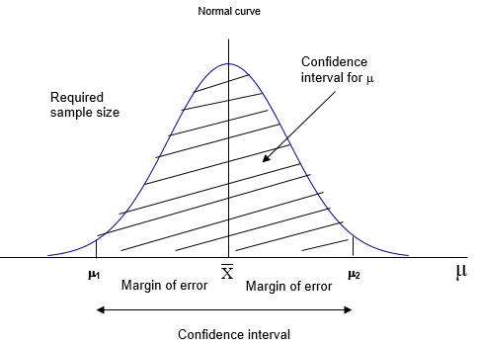
Calculating sample sizes (3/3)
If $\overline{x}−μ$ is effectively an error E, we can now re-arrange equation (5.26) into:
This gives the sample size n, as per equation (5.27):
(5.27)
Figure 5.40 illustrates the relationship between confidence interval, margin of error, and size of sample.

Slide 27

Example 5.7
A researcher requires to determine the sample size to be calculated with a margin of error of no more than 0.10 units of alcohol in total and with 98% confidence. Historical data provided to the researcher indicates that the population data is normally distributed with a population standard deviation of 0.2 units of alcohol.
Information provided:
Population data normally distributed
Confidence interval = 98%
From table 5.3, Z_{cri} for 98% CI = ± 2.326347874
Population standard deviation = 0.2 units
Required margin of error e = ±0.05 units (=0.10/2)
The sample size can now be calculated using equation (5.26).
To meet the requirements of the researcher, a sample size of 87 is required.

Slide 28
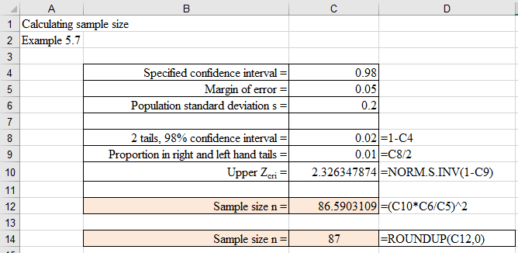
Example 5.7 Excel solution
Thus, to produce a 98% confidence interval estimate of the mean, we need a sample of 87.

Slide 29
Example 5.7 SPSS solution
No SPSS solution

Slide 30
Conclusion
In this presentation we explored the concept of a sampling data values from a population:
Point estimates
Confidence intervals
Sample size

